Slide 1

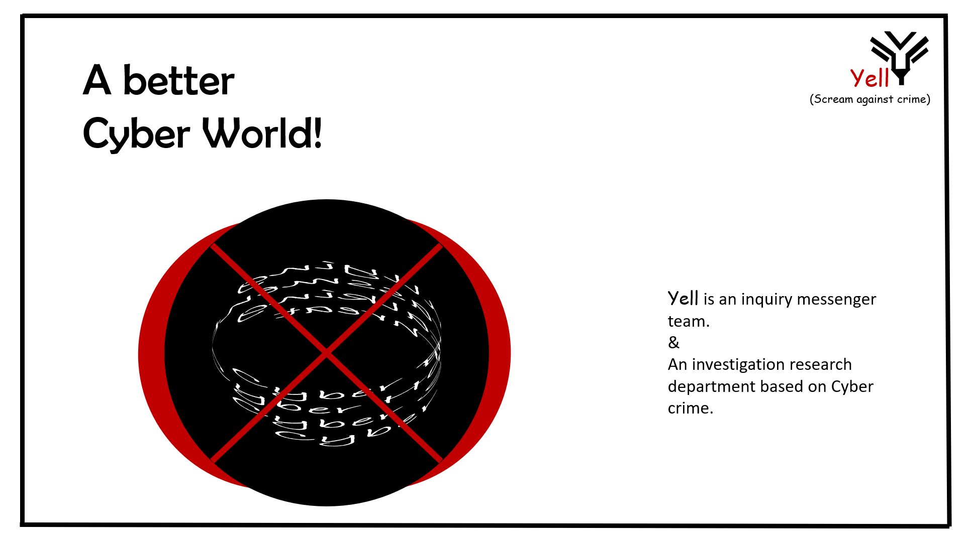
Yell (Scream against crime)
Tisha Khandokar
ID : 192-35-459

Slide 2
Yell (Scream against crime)
Software Requirement Specification
Table of Contents
Chapter1-Introduction Chapter 2-User profile Chapter 3-Functional and Non-Functional requirement In chapter 4-Graphical Representation Chapter 5-Storyboard Chapter 6-Database Table Chapter 7-Test Case Chapter 8-Traceability Matrix Chapter 9- System Architecture
Chapter-10- Motive & Exist Problem
Chapter-11- Objective
Chapter-12- Future Scope

Slide 3
Yell (Scream against crime)
Chapter 1 Introduction
The purpose of this document is to describe about our project named yell (scream against crime)with first release. This document contains the functional and non-functional requirements of the project and also user profile, use case, database and storyboard. This document contains the guidelines for system engineers and designers to start working the project
Scope
Yell is an inquiry messenger team. And also an investigation research department based on Cyber crime
Develop it for cyber aggreges ion or victim.
The victim get help from this
By paying information and case evidence ;victim submit it.
By analyzing and collecting data admin can get solving path
The project task begin In the 2021 January and Primary Ends will be In the Mid of April.(Approx.)

Slide 4
Chapter 2
Yell (Scream against crime)
User Profile
Definition:
A user profile is a visual display of personal data associated with a specific user, or a customized desktop environment.

Slide 5
User profile: 1 (Admin)
User Class: Customer | Characteristics | Requirement Implied
User type | Admin | Controlling
Age range | 10-65 | No need
Number of users | Restricted | Bandwidth should be high
Education | Graduation over CS,Management,law | Simple interface
Language Skill | English | Simple English
Computer/ Mobile Knowledge | Good skilled | Cyber Expert or Stratigic
Training | Yes | Security system
Goal | Scream against crime | Always active for instant response
User profile: 2 (Victim)
User Class: Manager | Characteristics | Requirement Implied
User type | Victim | Input
Age range | 10-65 | No Need
Number of users | Unlimited | Bandwidth should be normal
Education | Primary | Simple interface
Language Skill | English | Very Simple English
Computer/ Mobile Knowledge | Yes | Only type or click option
Training | No Need | No Need
Goal | Scream against crime | For solving give info

Slide 6
Chapter 3
Yell (Scream against crime)
Functional Requirement and Non Functional Requirement
Functional Requirement:
A Functional Requirement (FR) is a description of the service that the software must offer.
Non-Functional Requirement:
Nonfunctional Requirements (NFR) define system attributes such as security, reliability, performance, maintainability, scalability, and usability.

Slide 7
Admin
Functional Requirement | Description
FR01 | Analysing and collecting data the pannel confirm the issue as a case(Data would be readable)
FR02 | On this kind of serial case instant action must be done by Cyber expert.(Experts will be using cyber security law)
FR03 | Complete and pass for law pannel.
FR04 | Admin take the issue in media or seminar for awareness
FR05 | Uploaded Video,Photo,Article by Admin also.
Section
Complain
Processing
Case Transfer/Law
Media & Law
Blogging
Victim
Functional Requirement | Description
FR01 | Bully or Victim person give the information to admin pannel with evidence and proof.(Give true information evidence file can be JPG,PNJ,PDF)
FR02 | By submitting info they can also text or ask anything (By ask bar)
FR03 | They can contact for emergency help
FR04 | Upload video,photo and article will be available
FR05 | Media Like journal,channel,newspaper also helpful for victimization
Section
Complain
Ask Bar
About and Contact
Blogging
Media and law

Slide 8
Non-Functional Requirement | Description
NFR01 | All they are planned and assume for instant action.Within few hours.And service provided 24/7.
NFR02 | Case’s solved by various department like:Hacking,Harrasement,Threat,bullying,phising.Each department follow their own section.
NFR03 | Admin took all information in secure data mood
NFR04 | Psychiatrist based seminar,cyber related Blogging,Vlogging,Photo and various kind of activities will be held .
NFR05 | Each weeks updated the blogging and other awareness related activities

Slide 9
Chapter 4
Yell (Scream against crime)
Graphical Representation
Flow Chart
Use Case Diagram
Activity Diagram
Class Diagram
Sequence Diagram
ER Diagram
Business Model Canvas

Slide 10
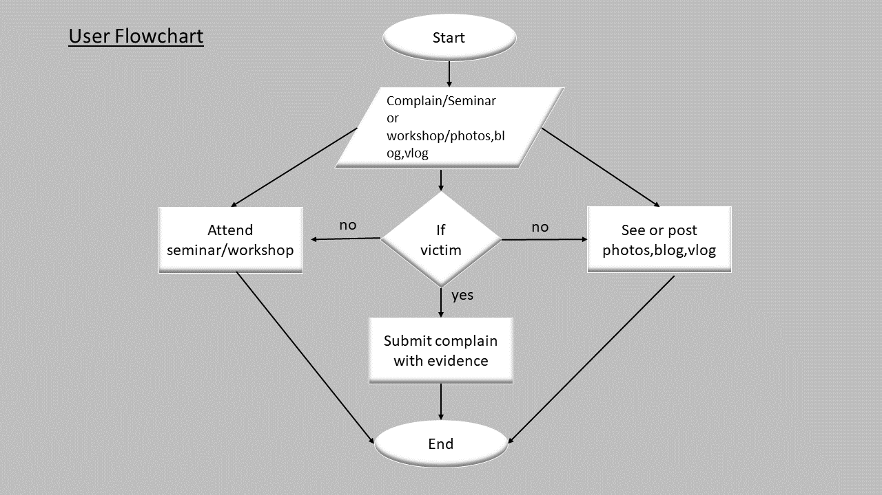
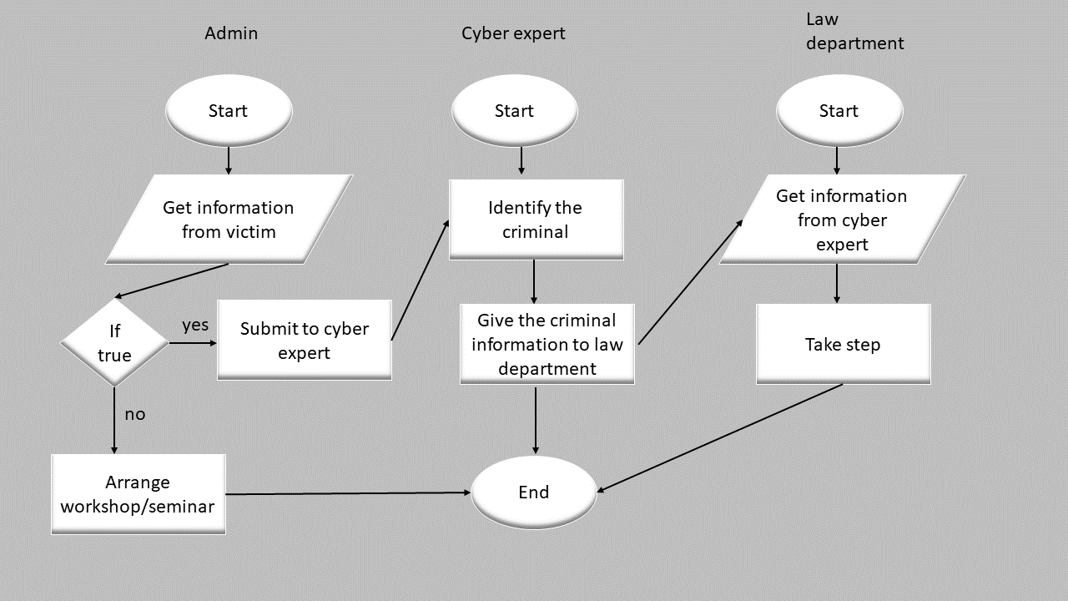
Flow Chart

Slide 11
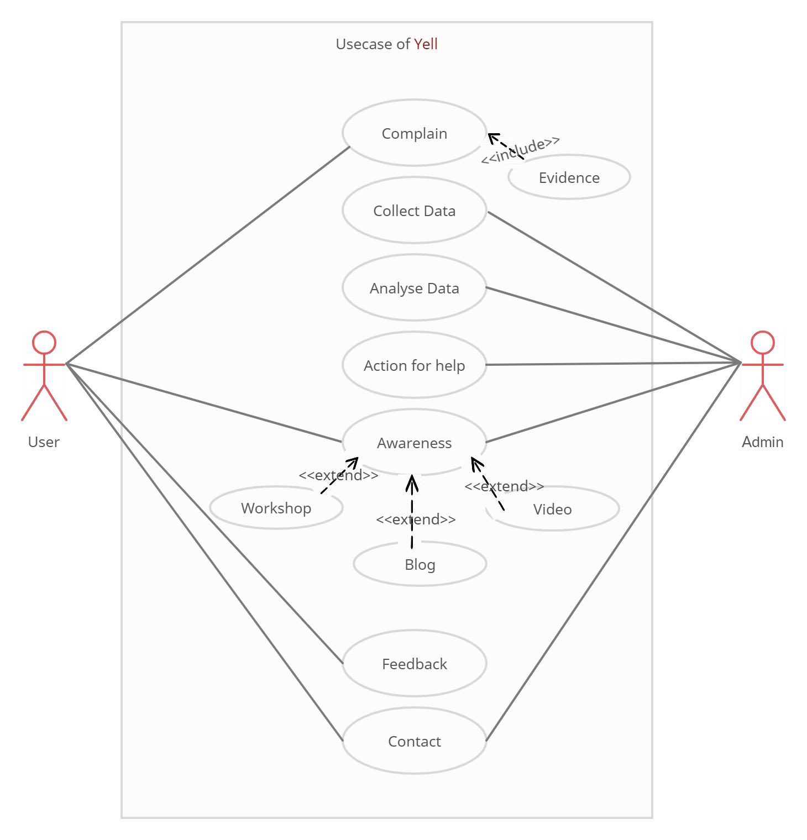
Use Case Diagram
Actor Admin User
Usecase Complain Collect data Analyze data Action for help Awareness Feedback
Include Evidence
Exclude Workshop Blog Video

Slide 12
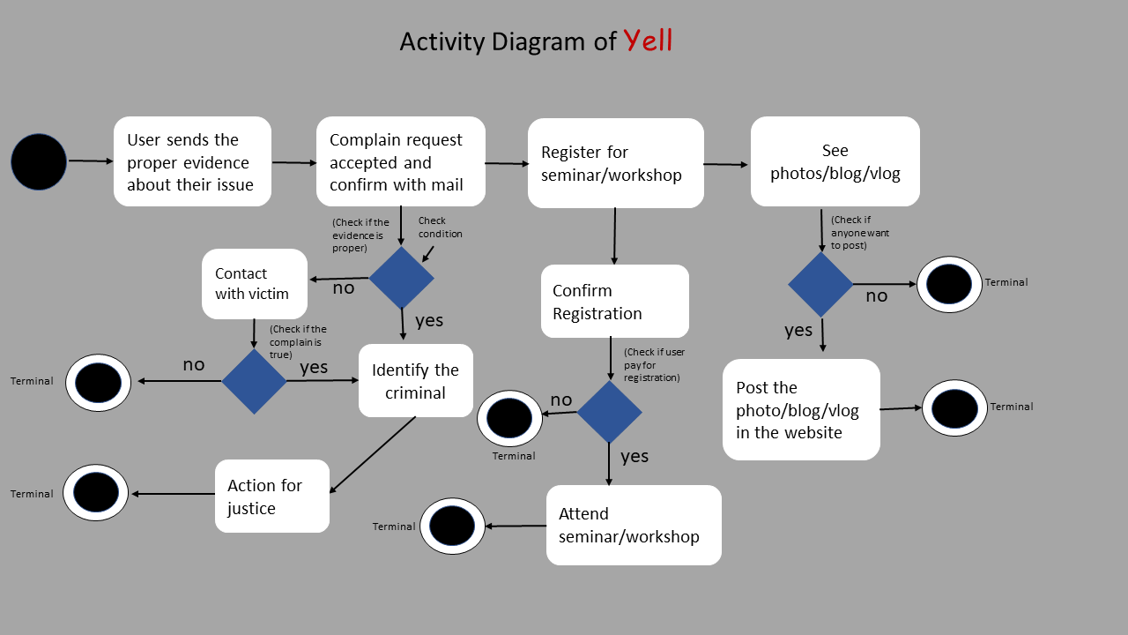
Activity Diagram

Slide 13
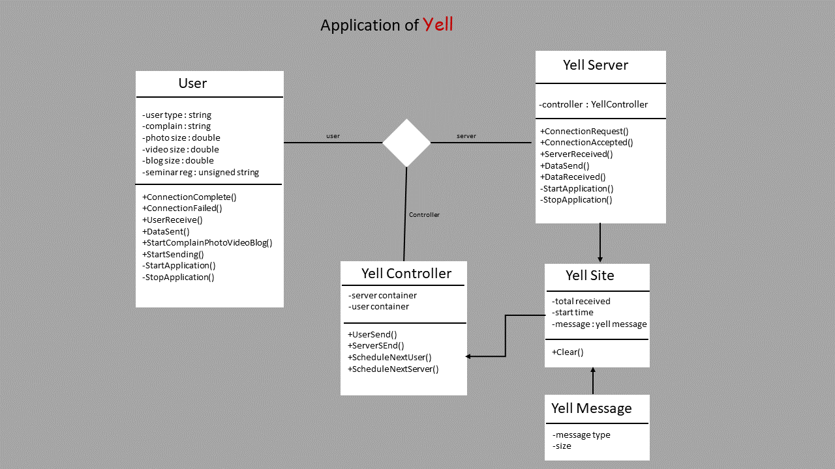
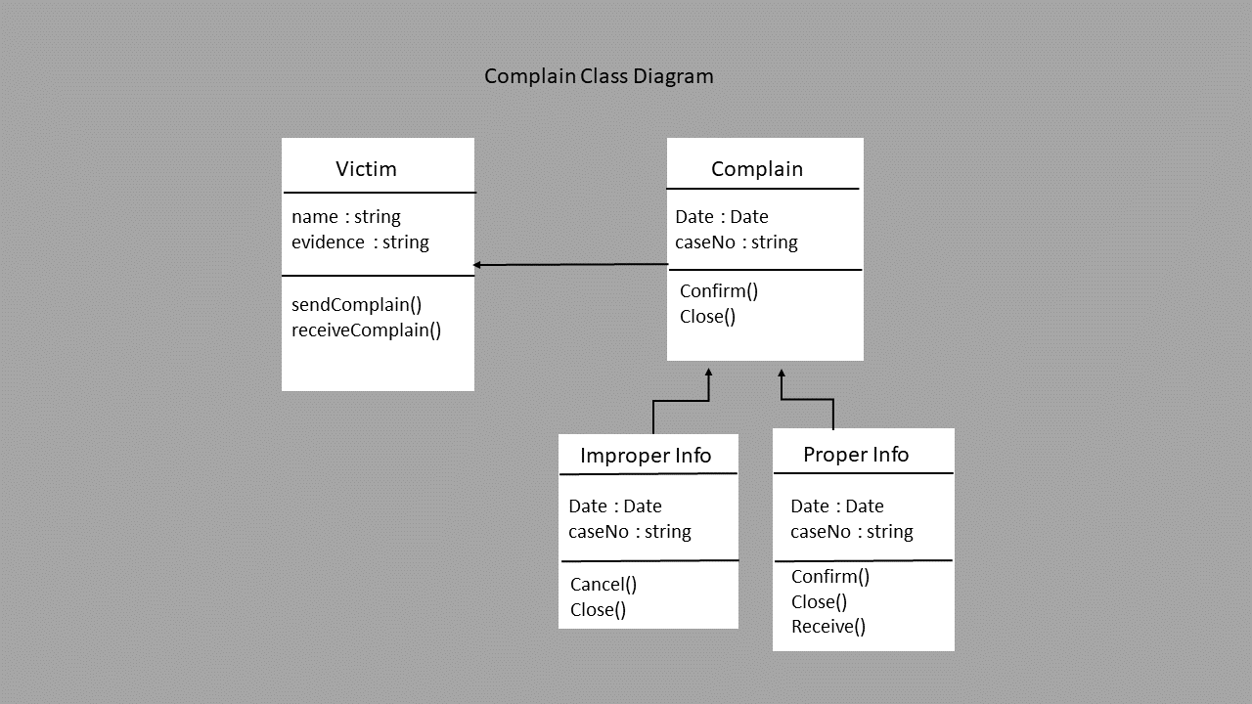
Class Diagram

Slide 14
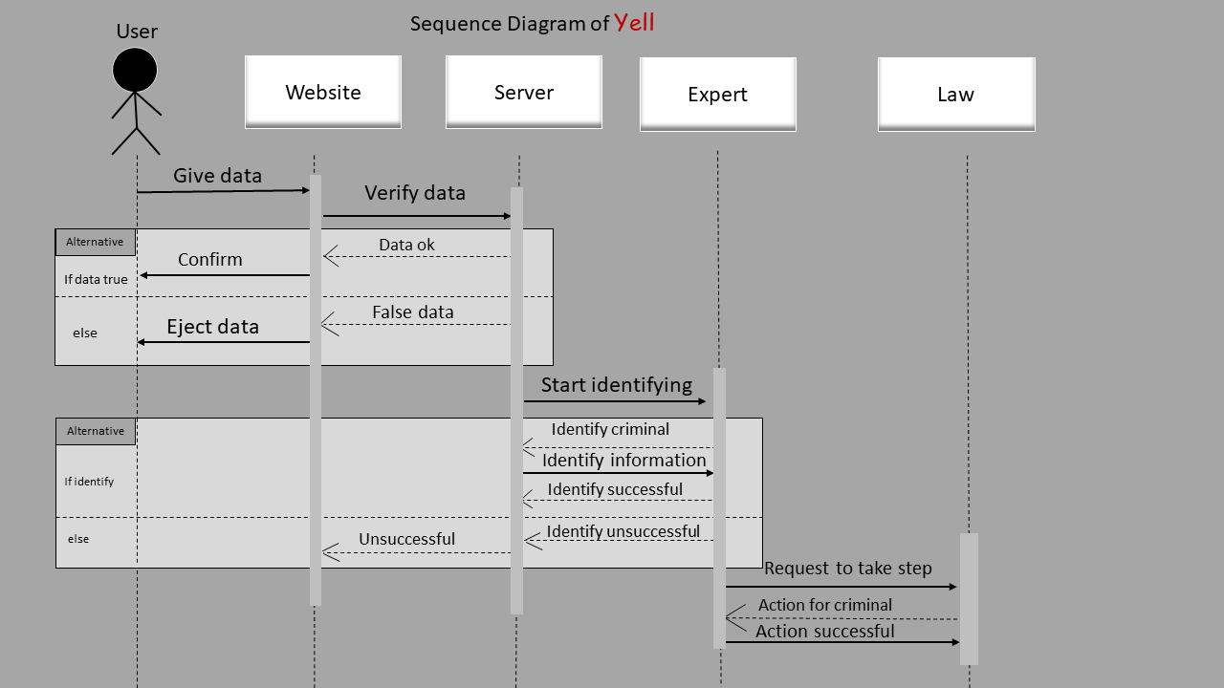
Sequence Diagram

Slide 15
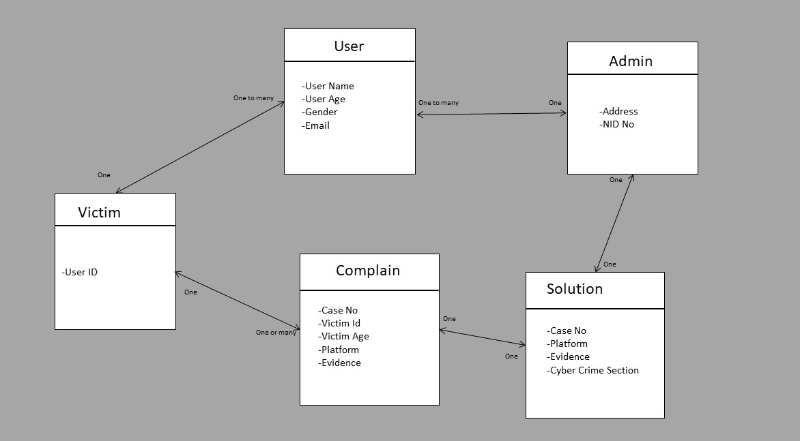
ER Diagram

Slide 16
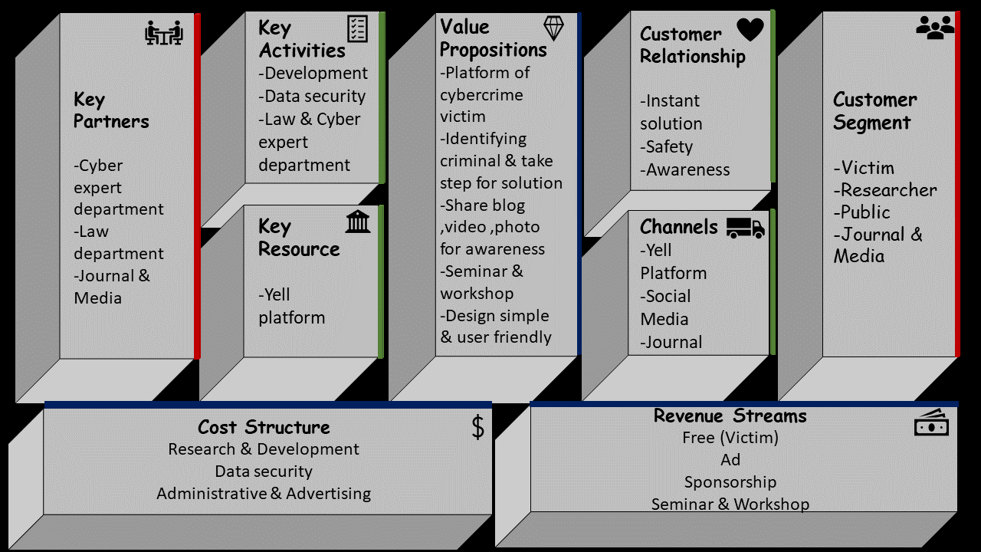
Business Model Canvas

Slide 17
Chapter 5
Yell (Scream against crime)
Storyboard

Slide 18
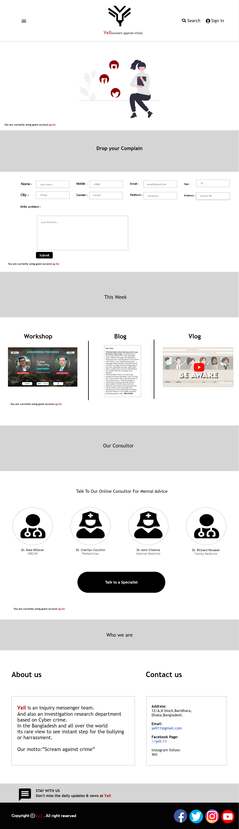

Slide 19
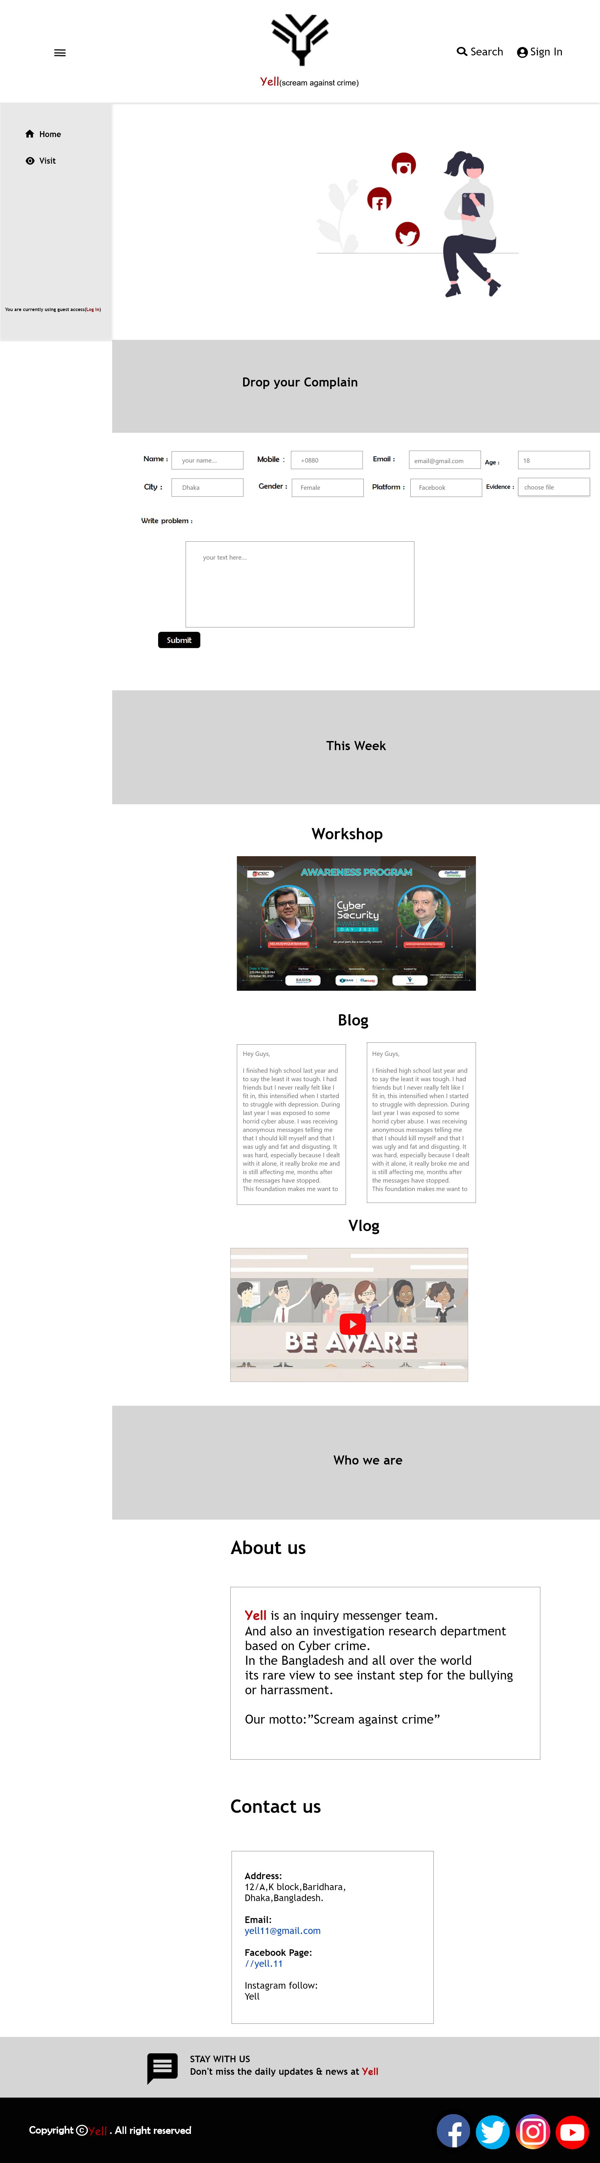

Slide 20
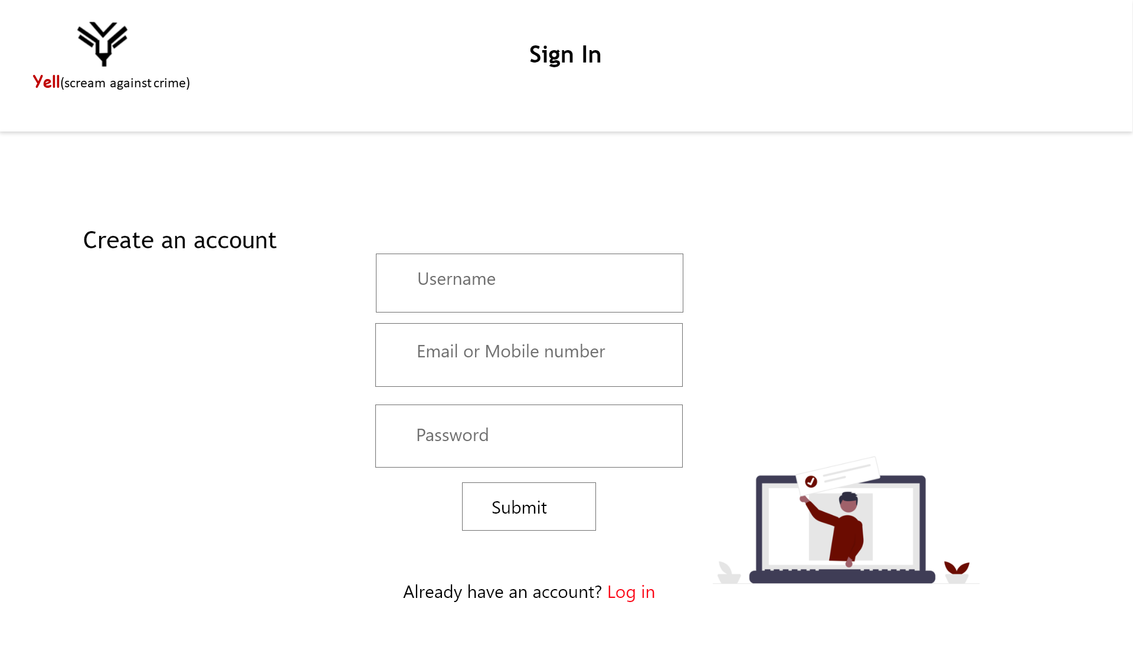

Slide 21
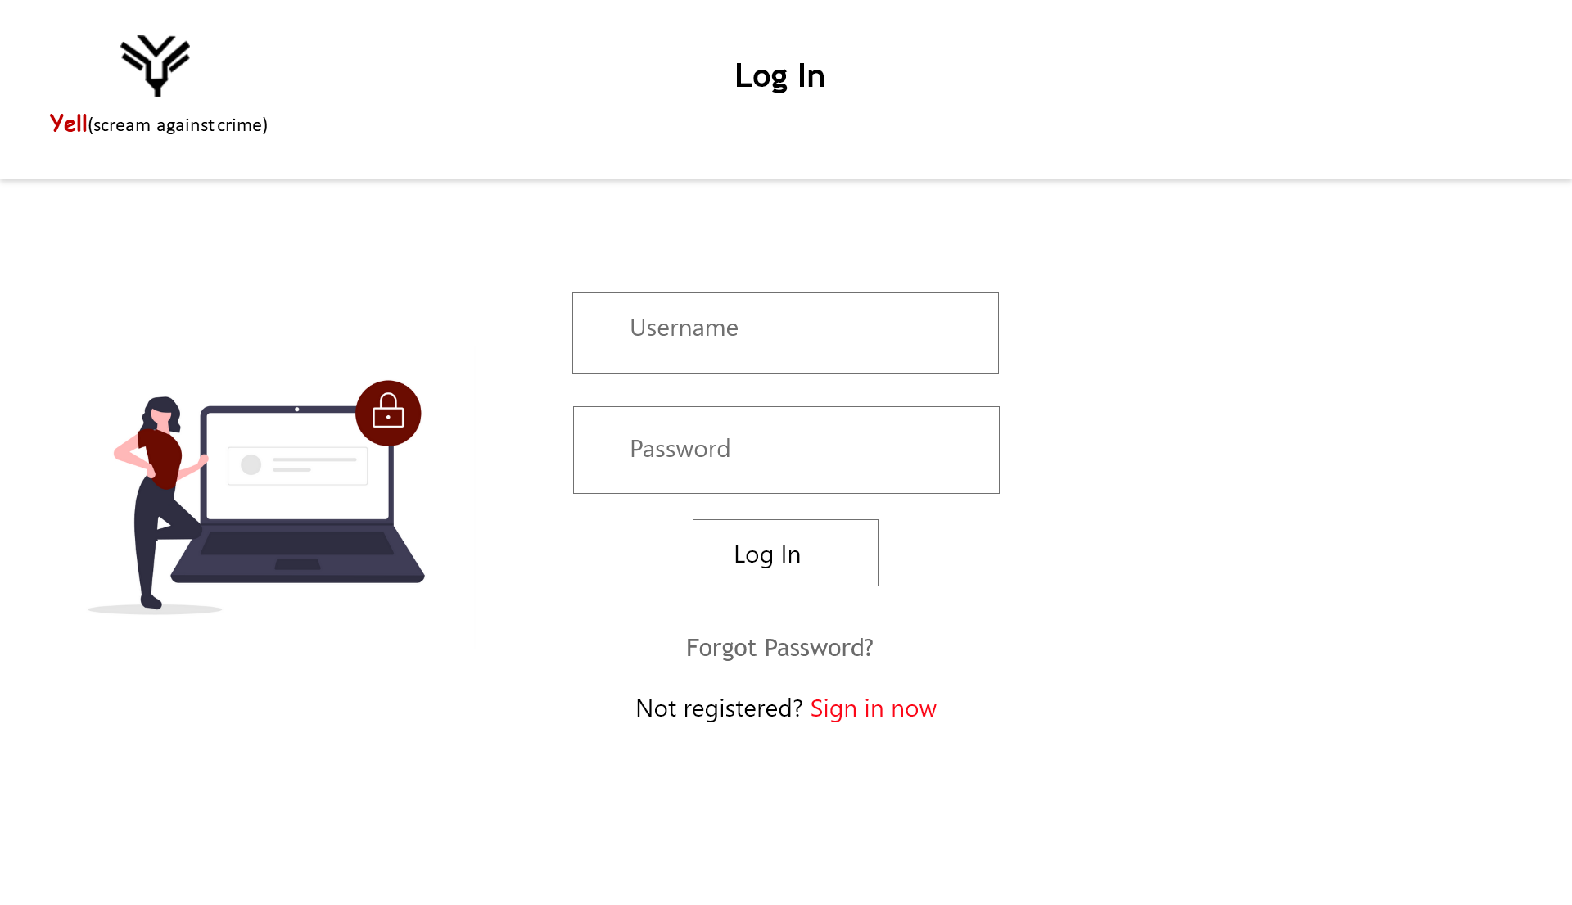

Slide 22
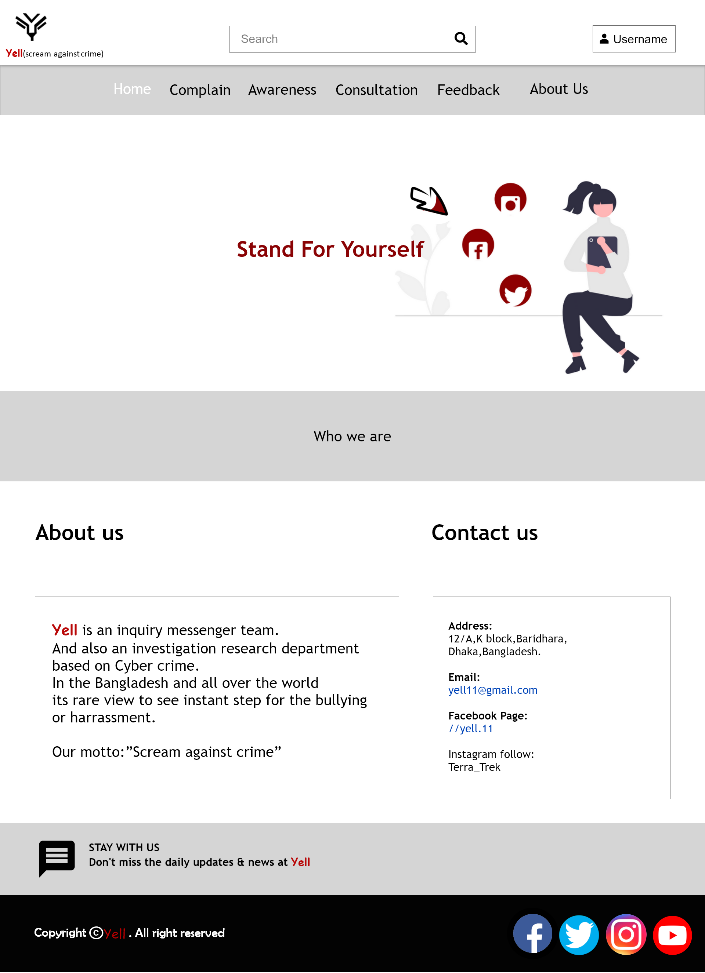

Slide 23
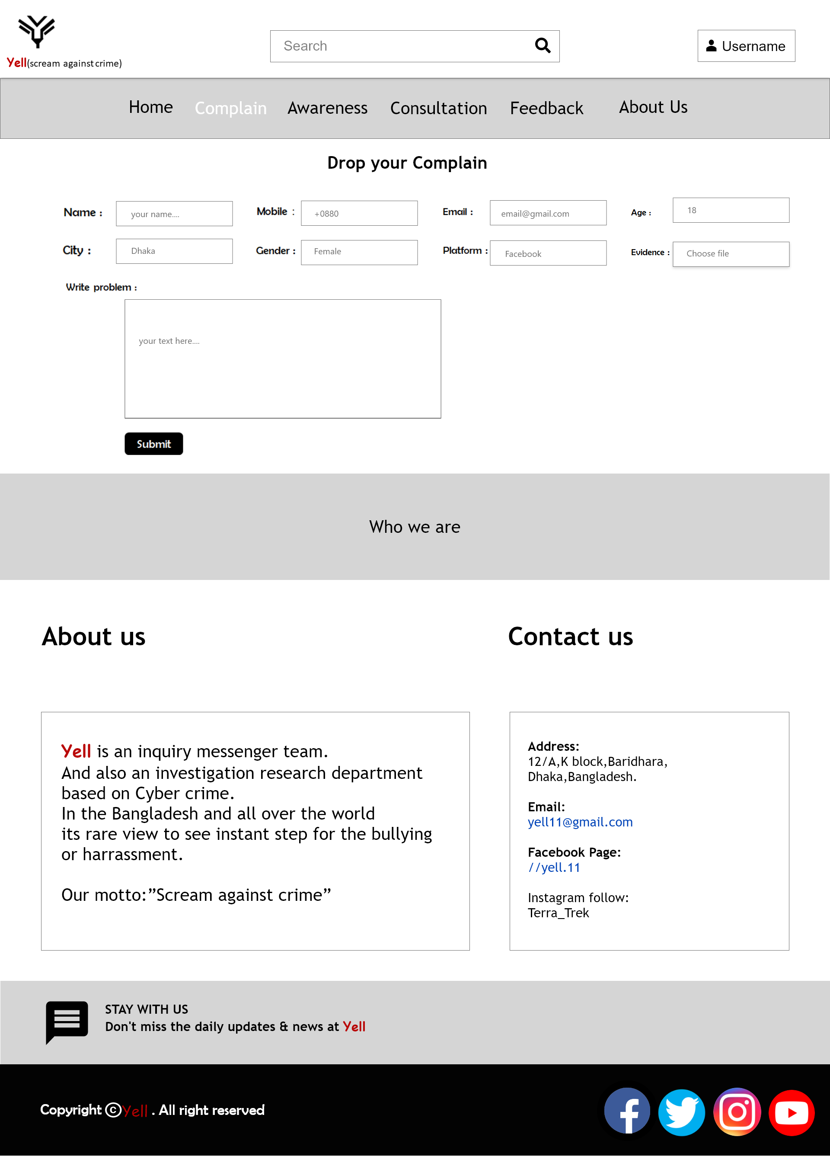

Slide 24
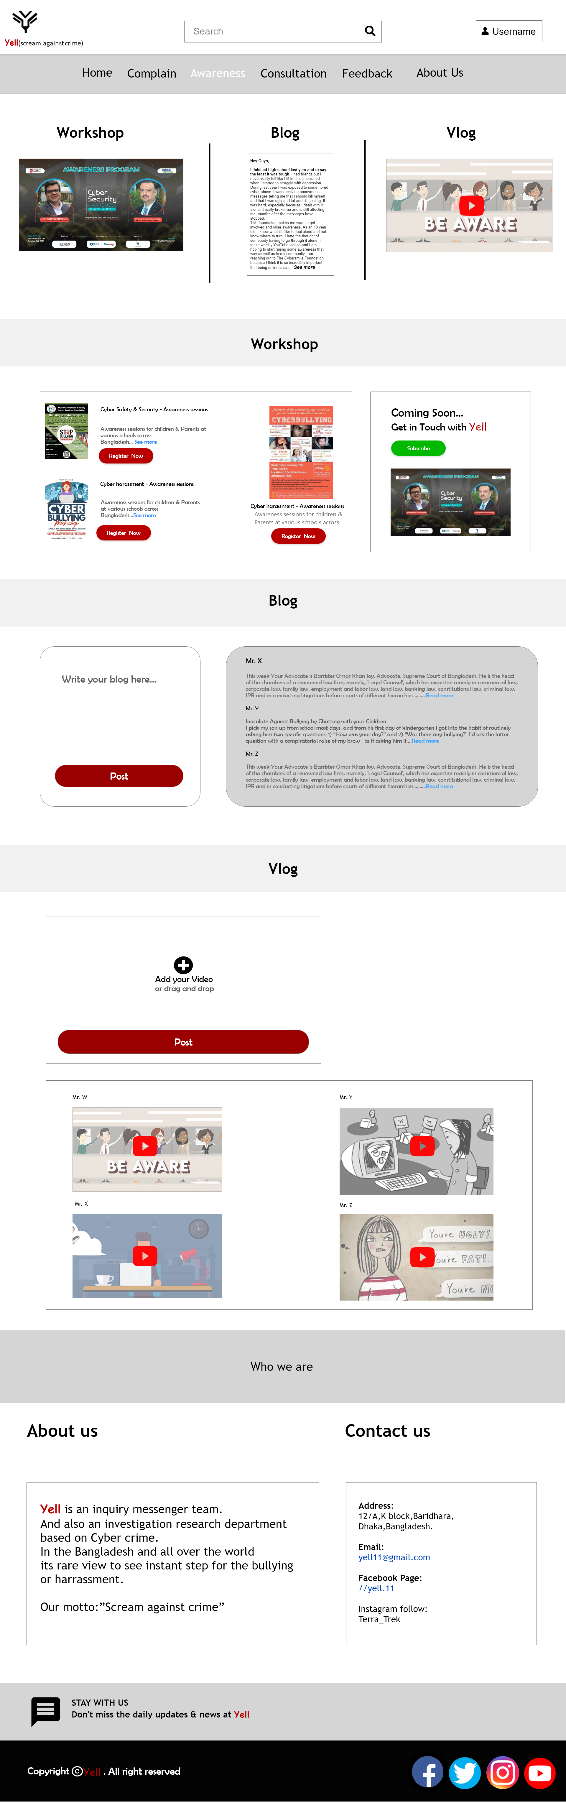

Slide 25
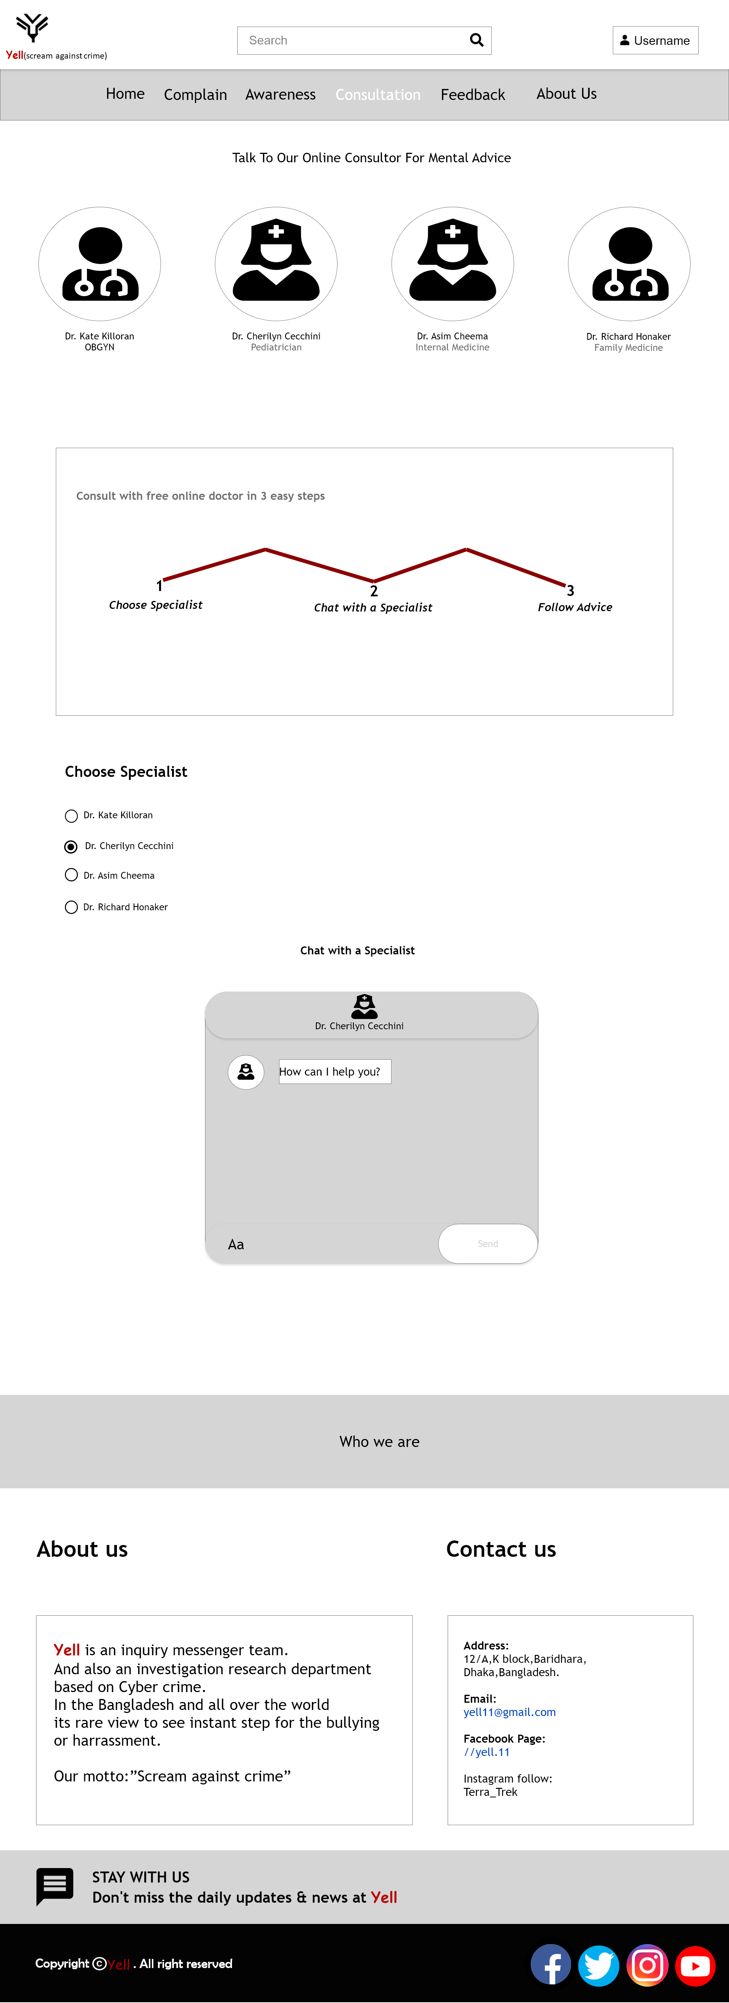

Slide 26
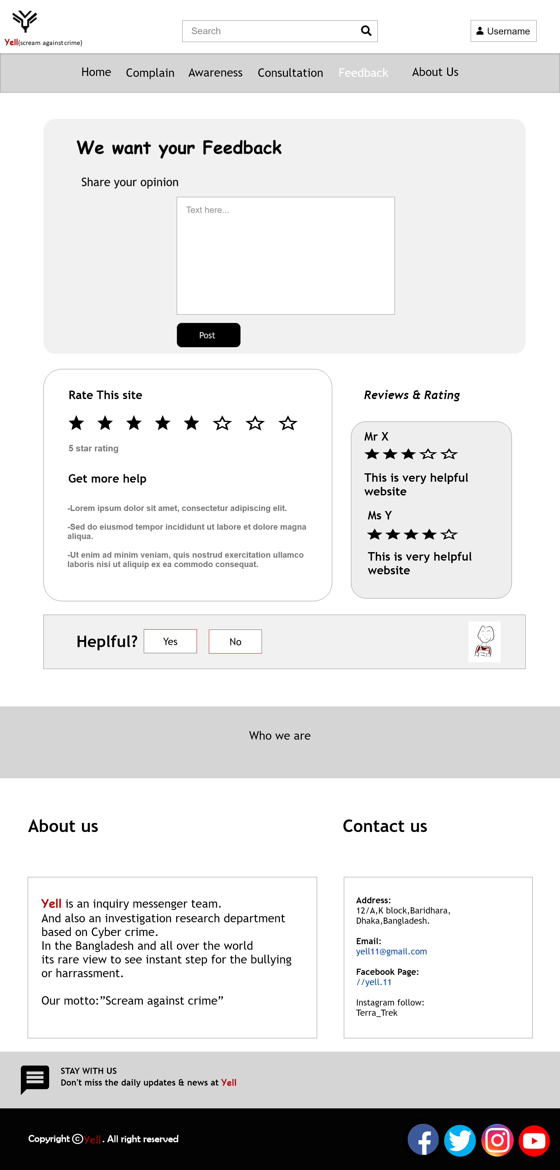

Slide 27
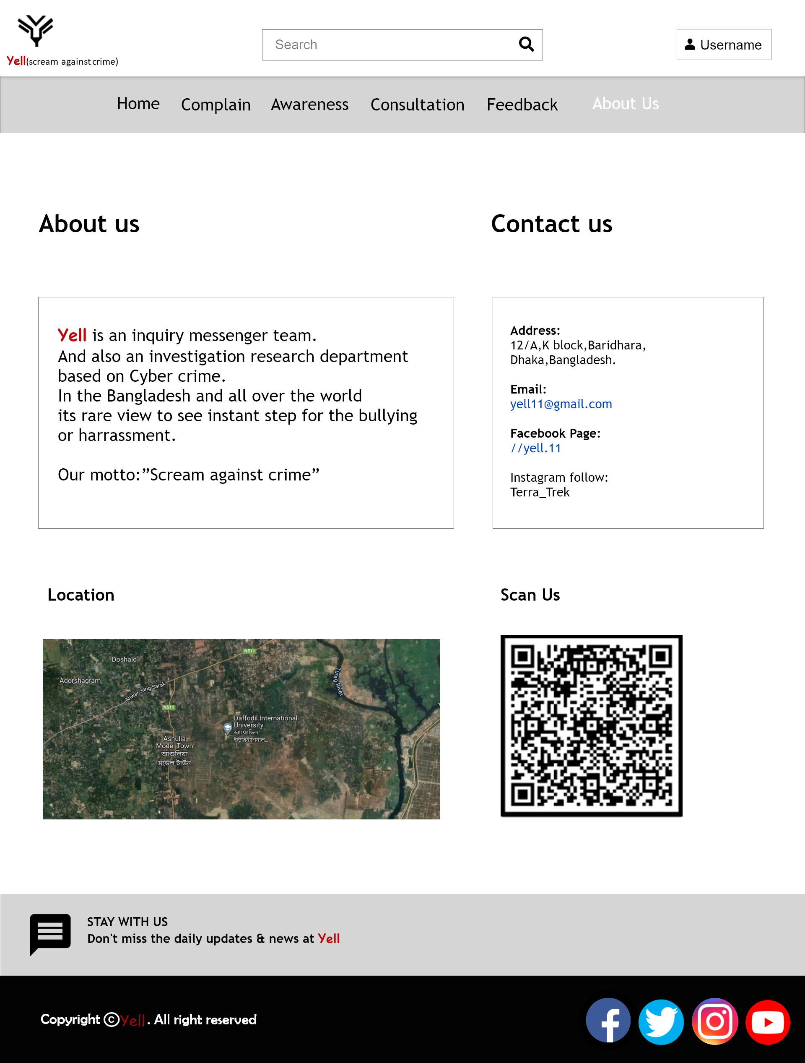

Slide 28
Yell (Scream against crime)
Chapter 6
Labels the database of system
Structure
Fields | Data Type | Constrains
Serial | Auto Number | It will start from 1
Case List | Text | From case 1 to case 10 , the investigate team collect or analyze data per day
Serial | Case List
1 | Case 1
2 | Case 2
3 | Case 3
4 | Case 4
5 | Case 5
6 | Case 6
7 | Case 7
8 | Case 8
9 | Case 9
10 | Case 10

Slide 29
Crime Table : tbl_crime
Field | Data Type | _{Constraints}
Crime No | Auto Number | It will starts from 1
Crime Section | Text | Section will provide by cyber based crimes
Platform | Text | Platform will select by victims where they faced these problems
Crime No | Cyber Section | Platform
1 | Cyber Bullying | Facebook
2 | Cyber Harassment | Website
3 | Cyber Threat | Instagram
4 | Cyber Teasing | Facebook

Slide 30
6.3 Process Table : tbl_process
Field | Data Type | Constraints
Case No | Auto Number | It will start from 1
Evidence | Numeric | All evidence must be uploaded in a single folder
Data Collection | All Type | All data will be given in one form
Identify section | Text | All investigation/law/cyber expert section will involve here
Action for solution / Justice | Text | Criminal will be punished
Case No | Evidence | Data Collection | Identify Section | Action for Solution/ Justice
1 | Pictures/Screen Shot/Link/Video | Form | Cyber Expert/ Cyber Investigation team | Law Department
2 | Pictures/Screen Shot/Link/Video | Form | Cyber Expert/ Cyber Investigation team | Law Department
3 | Pictures/Screen Shot/Link/Video | Form | Cyber Expert/ Cyber Investigation team | Law Department

Slide 31
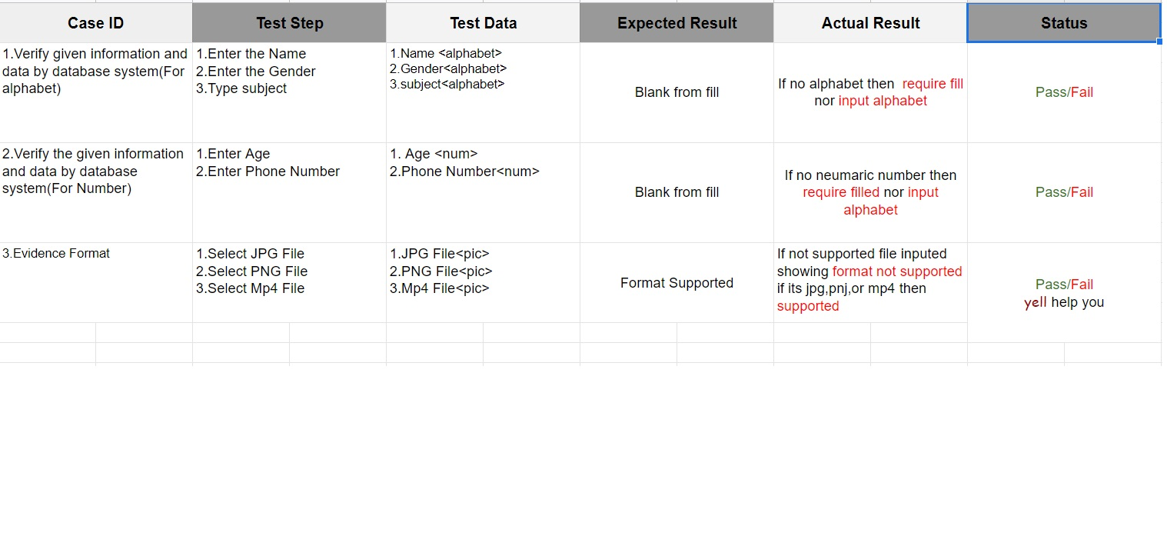
Yell (Scream against crime)
Chapter 7
Test Case
Spreadsheet Version
https://docs.google.com/spreadsheets/d/1SVAh66H6S0hx-yh8__r1eFKyoAbe2eQevIfF6HCf0hg/edit?usp=sharing

Slide 32
Yell (Scream against crime)
Chapter 8 Traceability Matrix
Serial | Functional Req | Trace
1 | FR.01(Admin,Victim) | Form.Information
2 | FR.02(Admin,Victim) | Form.Information
3 | FR03(Admin,Victim) | Form.User
4 | FR04(Admin,Victim) | Form.Admin

Slide 33
Yell (Scream against crime)
Chapter 9
System Architecture
Development tools :
Subline text editor
UI/UX tools
System Requirement
-On user side
Operating system (any)
Web browser
-On server side
Web server
Html
CSS
My SQL

Slide 34
Hardware Requirement
-On server side
P IV or above processor
1 GB RAM
120 GB HDD
LAN or WAN
Features
Secure
User friendly
Inexpensive
Fully informative
24/7 service provide
PPT, PDF,DOC,JPG,PNG,7zip all types of file sharing supported

Slide 35
Yell (Scream against crime)
Chapter 10
Motive & Existing problem
Cyber user is extremely increasing ;but the utilization of cyber is less than crime of cyber. In cyber its easy to make crime for criminal because of its all about behind the scene. For that they can easily make this occurrence and victims are uncapable to tolerate that kind of extreme crime. Sometimes victims are committed suicide also. To feel importance of the situation we make the Yell that help scream against such crime. And always works as an inquiry team to prevent hacking, threating, bullying and also make awareness for cyber.

Slide 36
Objective​
Yell (Scream against crime)
Chapter 11
​Everybody needs a good mental health .As Human Being We are taking an initiative way to give peace for those mentally depressed people​​
-It will give a platform to complain about their issues ​​ -Make public awareness for Cyber-bully by blogging ,vlogging or any kind of content. ​​ -Seminar or workshop plan for victim ​​
By regarding these we can ensure the victims problem and making a good cyber world​​.

Slide 37
Yell (Scream against crime)
Chapter 12
Future Scope
Live chat Like, Dislike Account setting Improve security

Slide 38
Yell is waiting for help!

